Slide 1
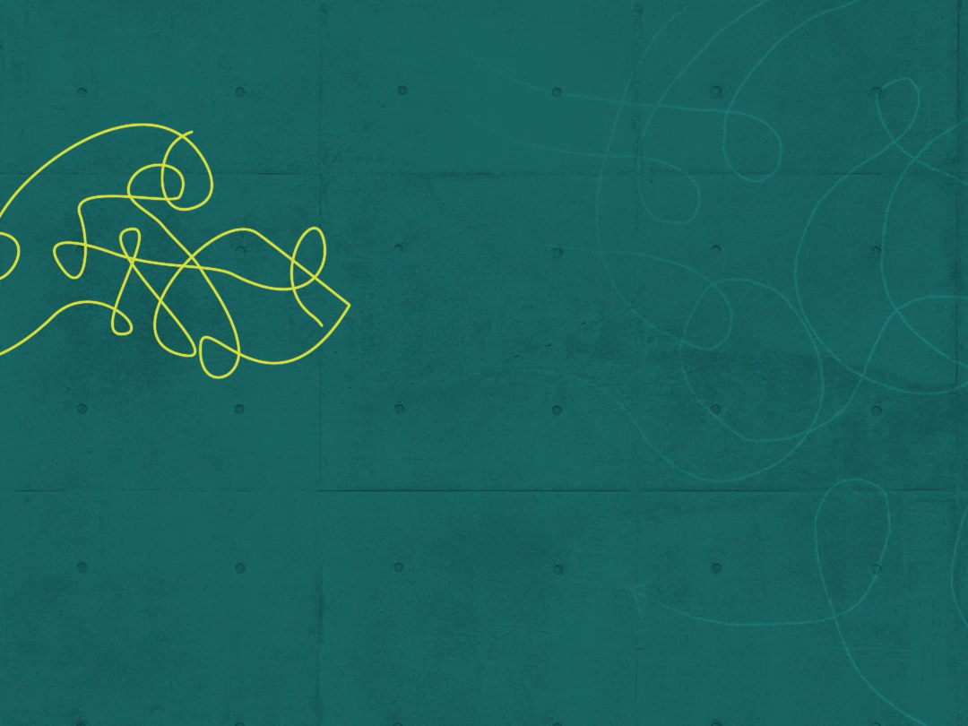
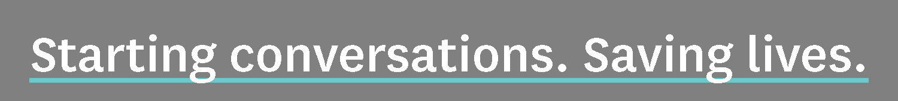
Notes:
Hello. I’m {name}, {title} with {organization}. Thanks for being here. Today we’re going to have a conversation about the movement to change minds in our community when it comes to alcohol and drug addiction and addiction care. My presentation will last about 20 minutes, then we can spend the rest of our time together continuing the conversation.
This movement is spearheaded by the Health District of Northern Larimer County and supported by the Mental Heath and Substance Use Alliance — a collective of 35 local agencies representing consumer advocates, education, healthcare, law enforcement, criminal justice and the faith community, including {list members that are relevant to audience}.

Slide 2

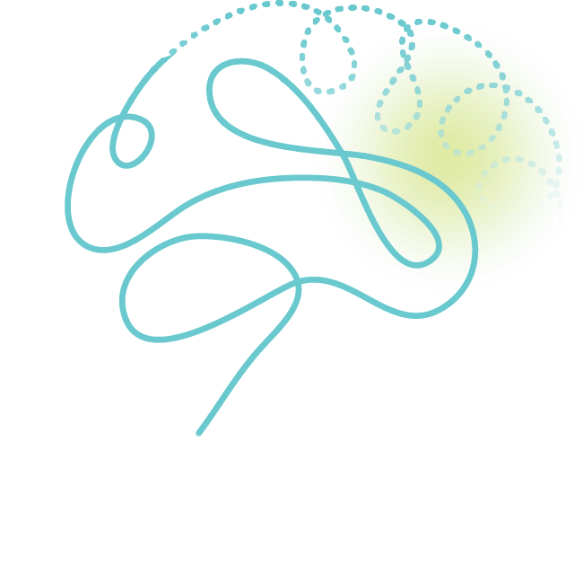
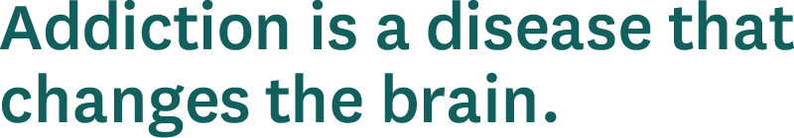
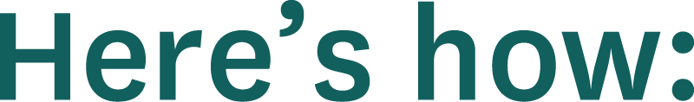
Notes:
We’re talking about changing minds and brain science for one simple reason: addiction is a disease that changes the brain. (A) Here’s how:

Slide 3
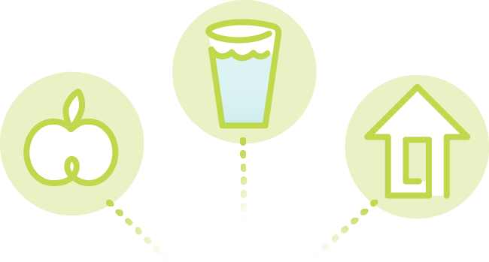
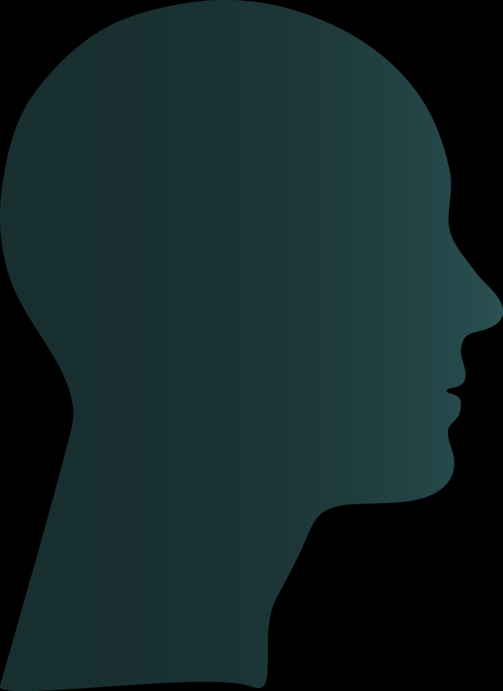
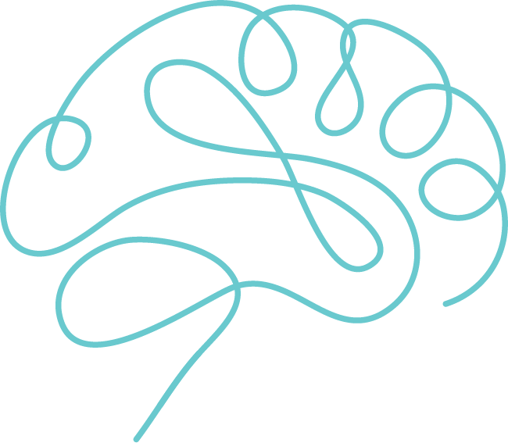



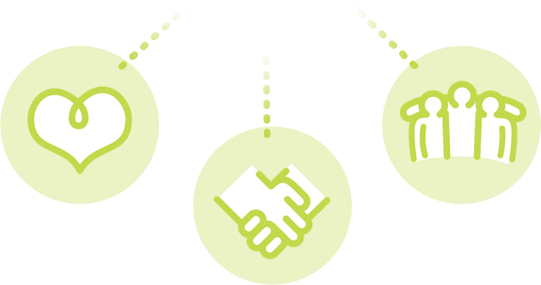
Notes:
Dopamine is our reward system and our main source of motivation. Its effect on the brain is immediate and powerful.
Our brains release dopamine (A) to reward us when we do what we need to survive, (B) like eat, drink and seek shelter.
Dopamine is also responsible for human connection. (C) Friendship, work camaraderie, love for your family — making meaningful connections releases dopamine, and it makes you feel really good.

Slide 4
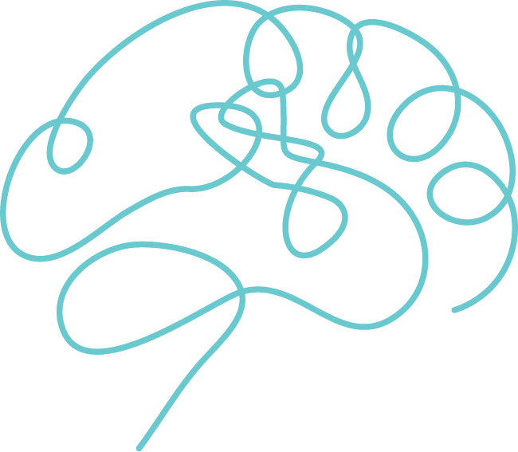





Notes:
The average person on the average day has a brain dopamine level of around 50 nanograms per deciliter.
On your best day ever — winning the Superbowl, getting married, seeing your child born {personalize if appropriate} — (A) your brain would get up to around 100, which is the most dopamine your brain is naturally wired to handle.
Now imagine your worst day ever — grieving the death of a loved one, losing your job. (B) On that day, your brain would be around 40.
Substance use throws those numbers off the charts. (C) Using methamphetamine, for example, cranks your brain’s dopamine level to 1,100 — 11 times higher than your best day ever, the most dopamine your brain can handle.
(D) That’s a big reward, so big that it fundamentally alters your brain.

Slide 5

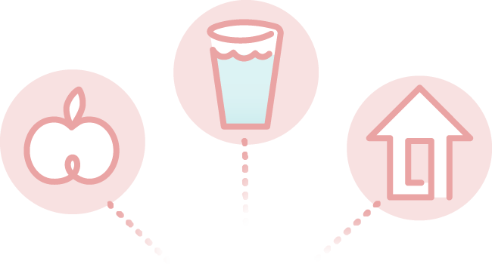
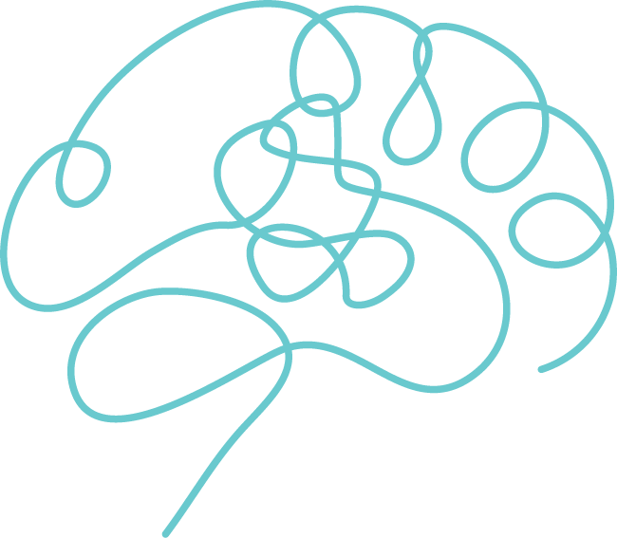
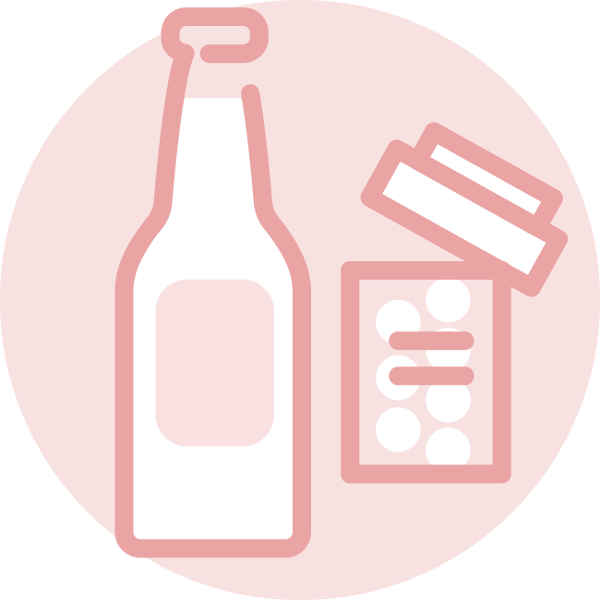
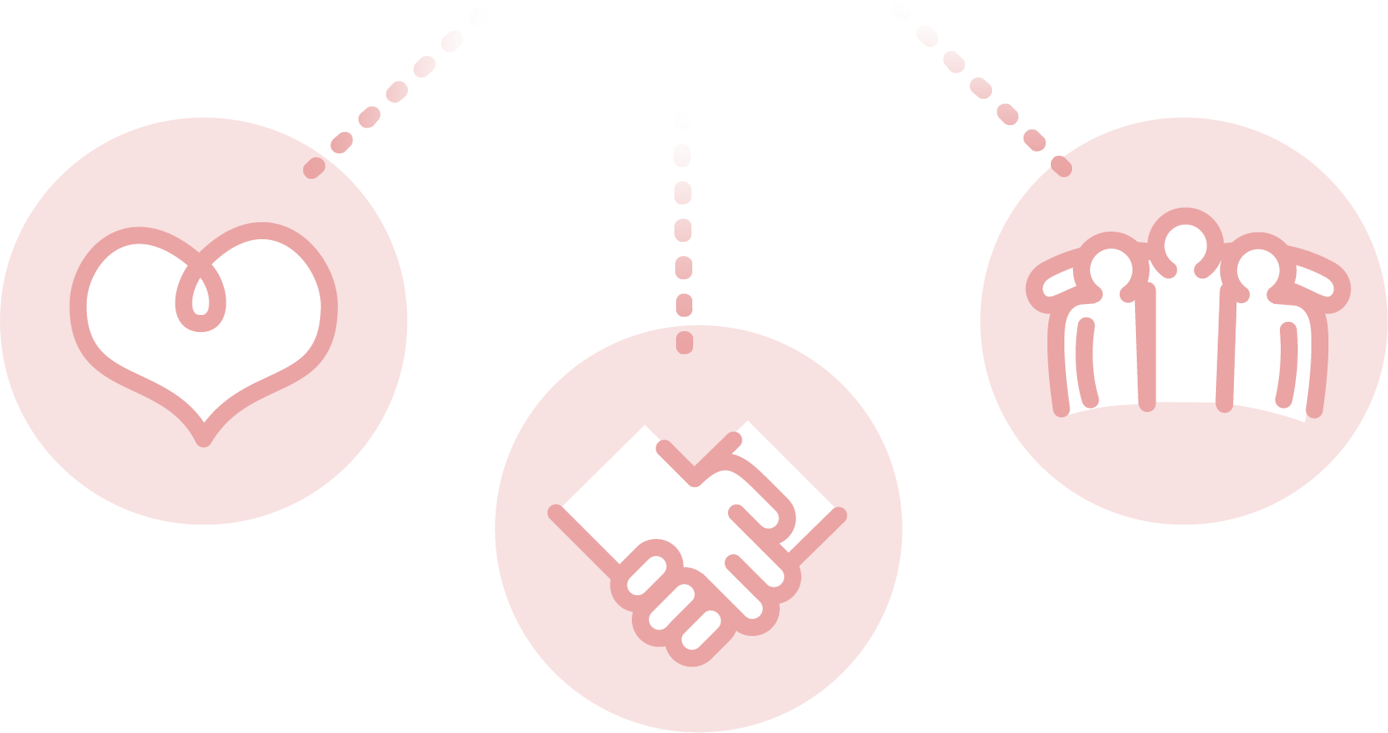
Notes:
Your brain is rewired — hijacked — to seek the substance to survive, (A) neglecting the things you actually need to survive.
(B) So, 50 is a normal level of dopamine in your brain. Meth is 1,100. Heroin is 975. Marijuana is 650. Your brain can’t ever reach those overinflated levels again, no matter how much you use. Instead, with repeated use, your brain regulates dopamine release — down to 900, 650, 300, 85 and eventually 30 — lower than your worst day ever. That’s how quickly a high turns into an all-time low.
Without the drug, your brain only produces a crippling dopamine level of 15-20. Motivation is gone. Human connections are gone. You can’t go to work, play with your kids … you can’t even get out of bed.

Slide 6
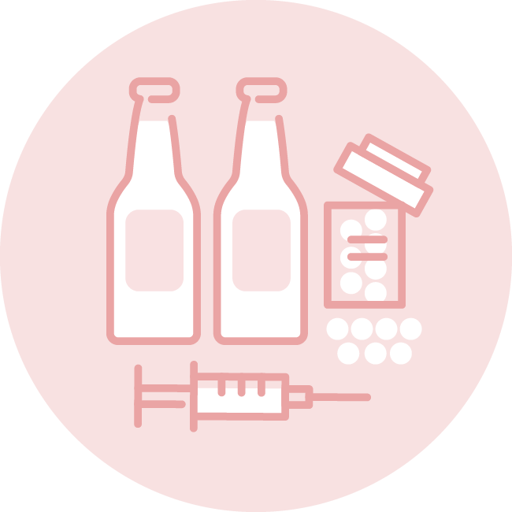
Notes:
It gets worse. Now you need to use more and more of the substance every day just to hit your new sub-normal dopamine level of 30. Your brain craves the substance so intensely it consumes your life. Choice turns to need — a do-anything, say-anything, who-would-choose-to-live-this-way need.

Slide 7

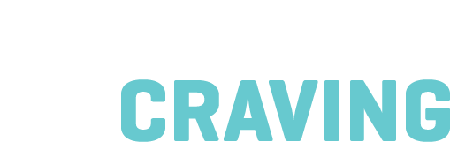
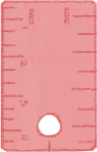
Notes:
Addiction physically changes the brain. It now sees the substance as your only requirement for survival.
How does the craving of an addicted brain for a drug compare to our cravings for survival basics? Northwestern University measured it.

Slide 8
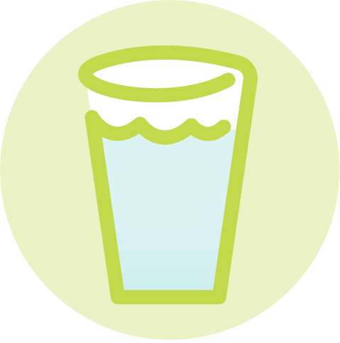
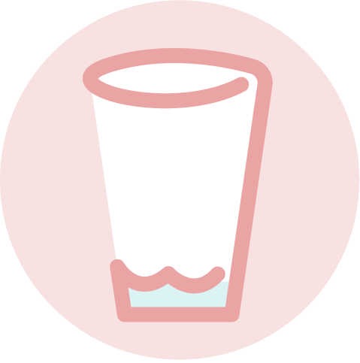
Notes:
Test subjects were deprived of water for three days. (A) Under MRI, they registered overpowering cravings for water.

Slide 9
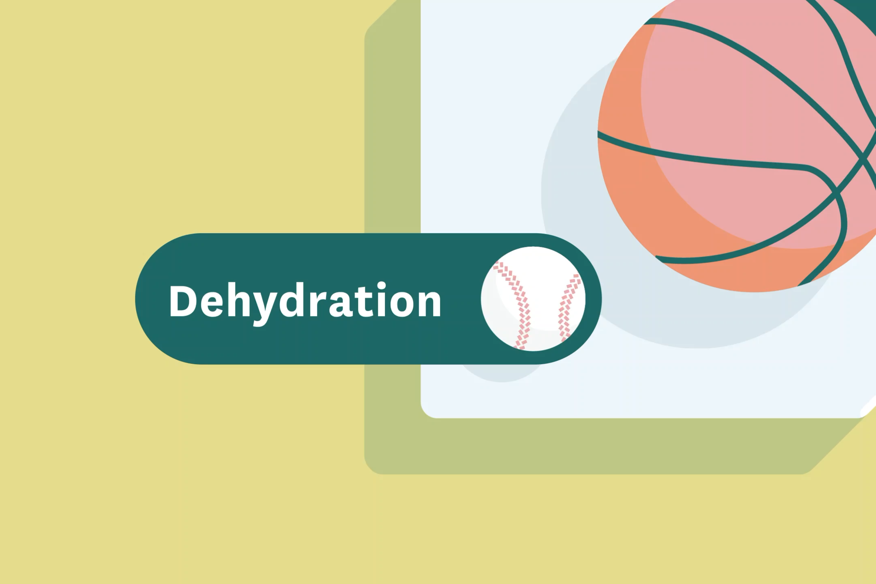

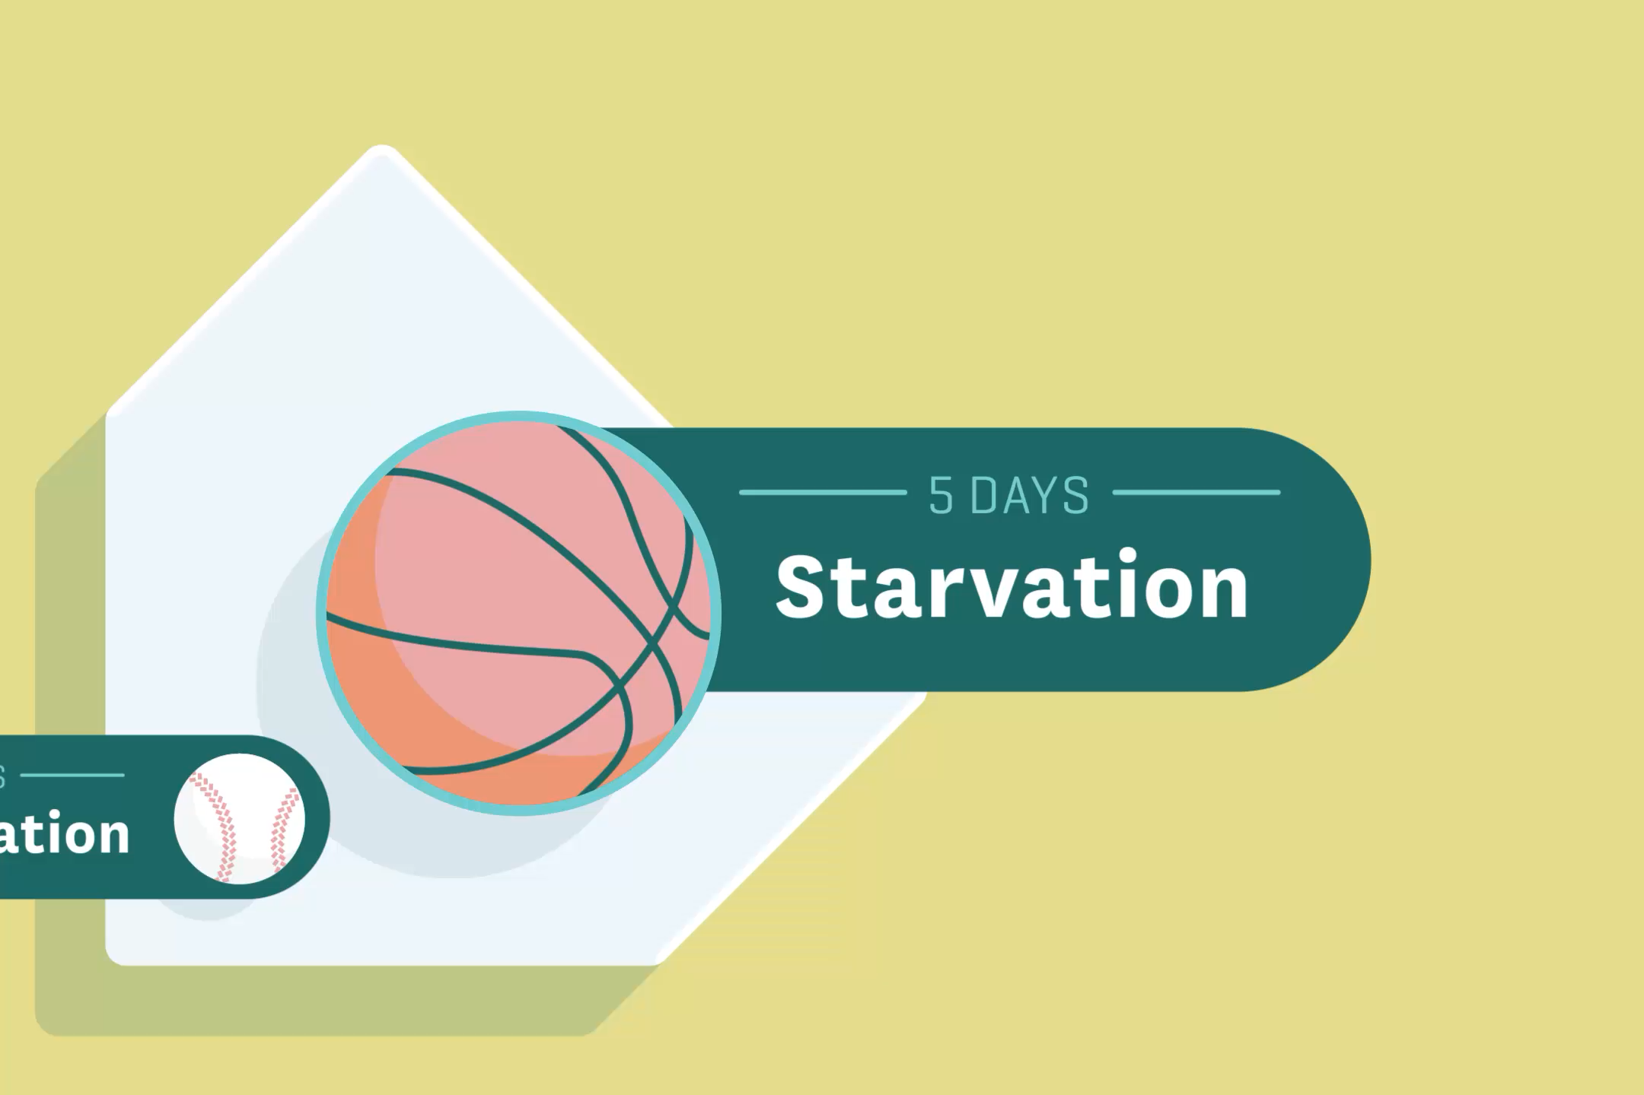
Notes:
Visualize that craving as the size of a baseball.
(A) Comparatively, subjects who went 5 days without food displayed a craving the size of a basketball.
(B) The craving for substances in the brains of people living with addiction measured the relative size of a baseball field. And the intensity of those cravings didn’t lessen until after 2 years of not using.
Imagine you’re in addiction recovery. Your brain is screaming 24/7 for a substance you’re trying to avoid — for 2 whole years. This, while your dopamine level is lower than your worst day ever. That’s the science behind why recovery is an ongoing, difficult process. But the brain can heal. It takes time, resources and compassion.

Slide 10
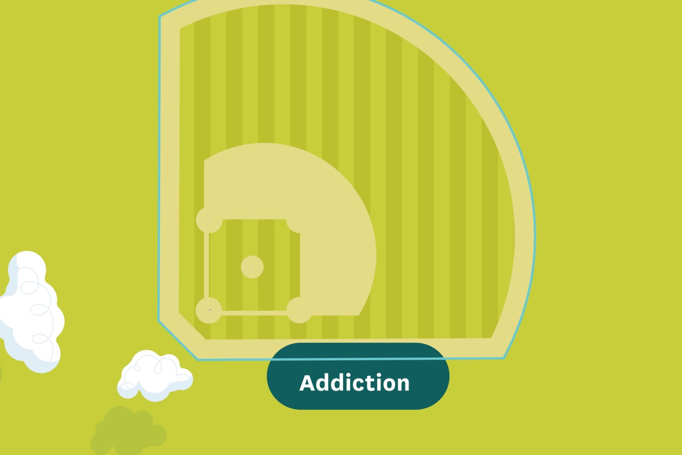
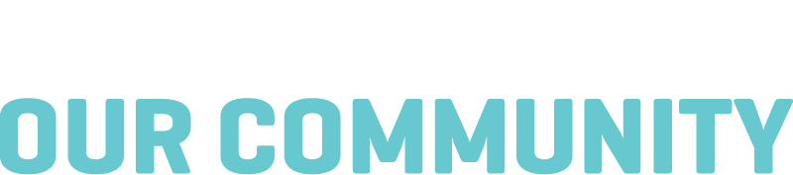
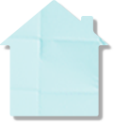
Notes:
Addiction is a disease that changes the brain, and addiction is a disease that impacts the entire community. Northern Colorado is consistently viewed as one of the best places to live and do business, with healthy people walking around all over the place. But the reality is, addiction lives here. Let’s look at the numbers.

Slide 11

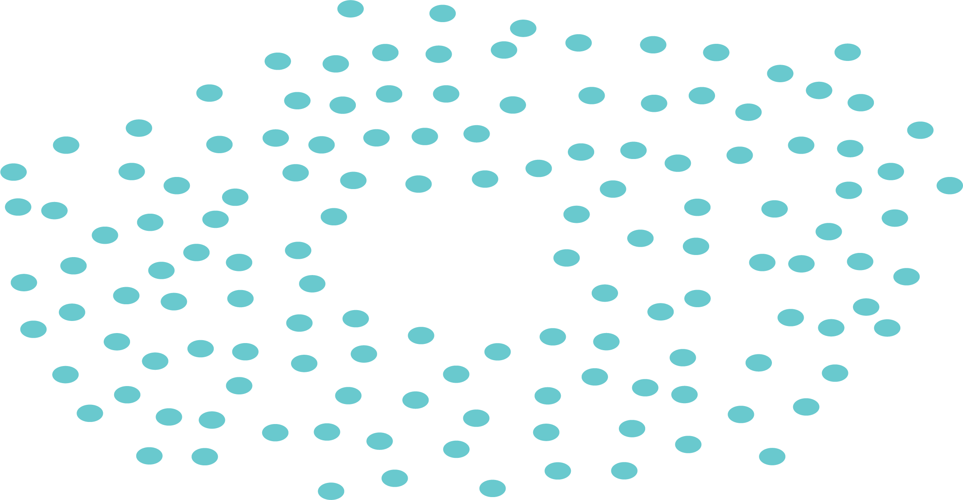


Notes:
Think of your 100 closest neighbors. Or look around the room. There are about {XX} people here. (A) Now imagine 10 of your neighbors are suffering from a potentially deadly disease. (B) But only 1 of those 10 will get the care they need. If 1 in 10 of our neighbors with cancer had access to treatment, we wouldn’t stand for it. Imagine your next-door neighbor gets diagnosed with diabetes and they can’t get the level of care they need. Worse yet, their doctor refuses to prescribe insulin because they don’t “believe” in medication to manage the disease.

Slide 12

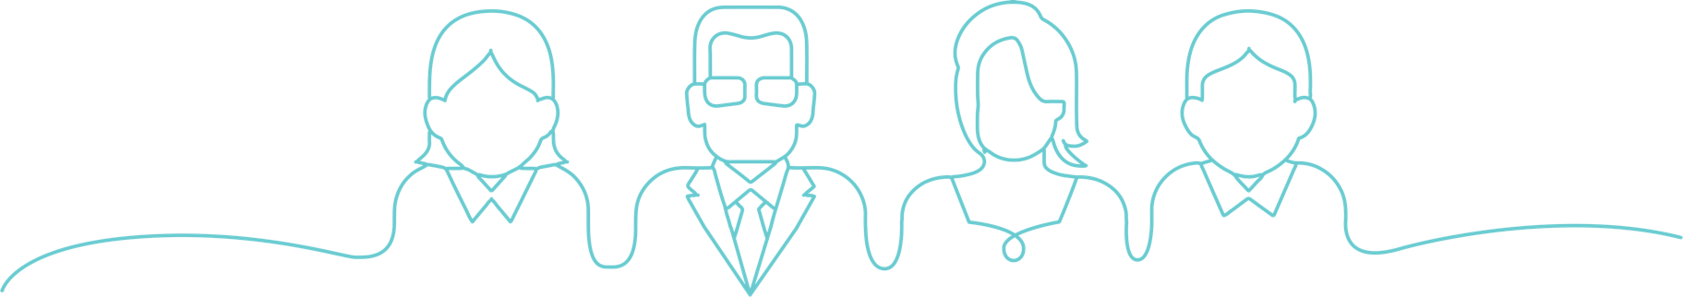
Notes:
Yet that’s the reality of addiction in Larimer County. And there is no “us” and “them”. Addiction affects everyone: teachers, teenagers, first responders {Rotarians, Boy Scouts, Lutherans or whoever you’re speaking to}.

Slide 13


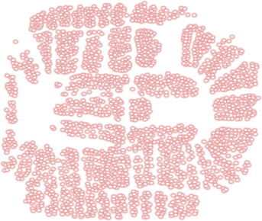
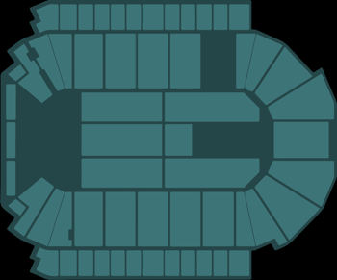
Notes:
When you step back and look at the bigger picture, that 1 in 10 adds up. 35,900 in Larimer County suffer from addiction. (A) That’s enough to fill the Budweiser Events Center nearly five times.

Slide 14


living with addiction
get treatment
in need of
addiction care
Notes:
1 in 10 of our neighbors will get the care they need. That leaves 32,310 in need of addiction care. That number fills the Bud Center four and a half times.

Slide 15
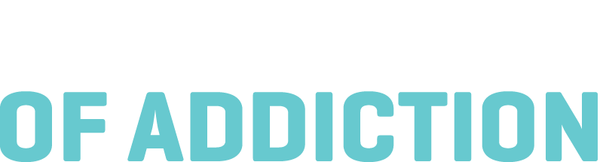
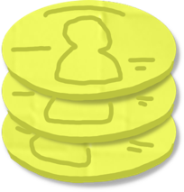
Notes:
Addiction is a big challenge, and it’s an expensive one. Let’s take a look at the cost of addiction in Larimer County.

Slide 16
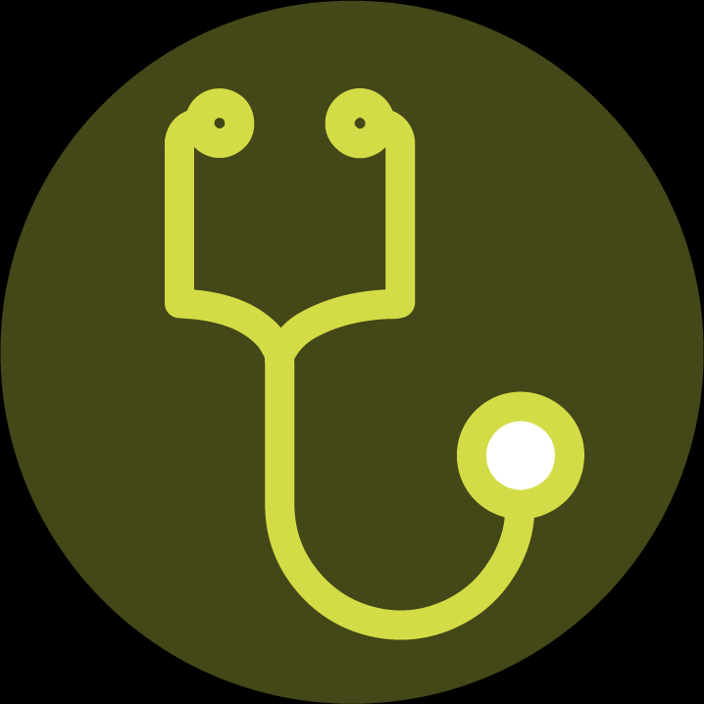
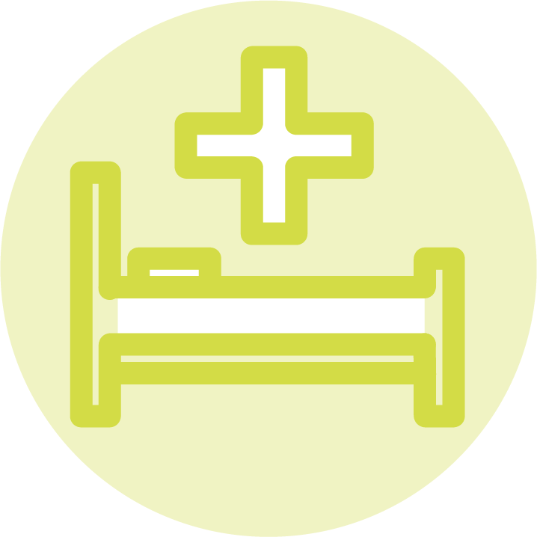
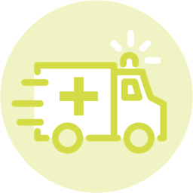
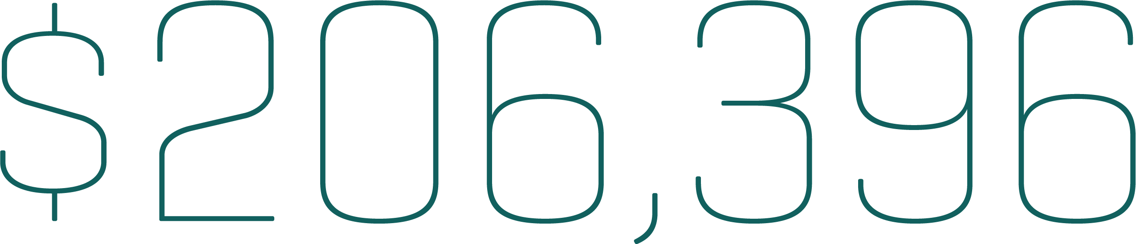
50
ER visits
10
hospital stays
8
ambulance rides
Notes:
Let’s look at one example. “Dan,” as we’ll call him, is a real resident of Larimer County living with addiction. In 2022 Dan made 50 visits to the ER, had 10 hospital stays and took 8 ambulance rides — for a total emergency health and crisis care cost of $206,396. Now, bear in mind, that’s just the cost of picking up the pieces of the damage caused by Dan’s addiction. None of that expense is treating his disease.

Slide 17
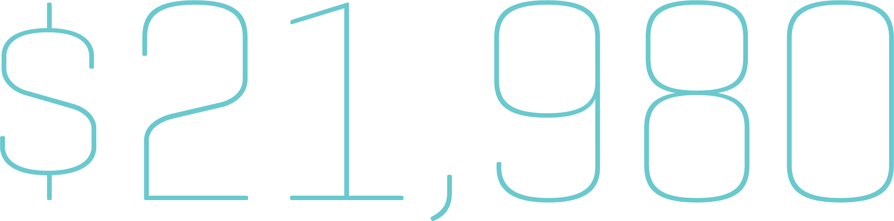
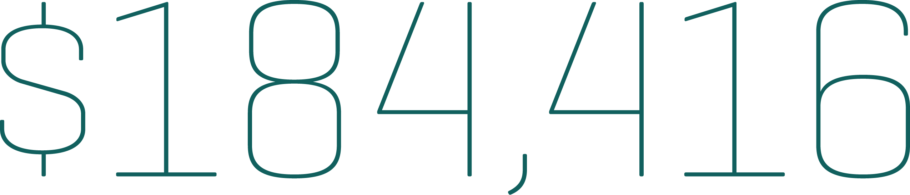
50
ER visits
10
hospital stays
8
ambulance rides
Notes:
In 2023, Dan started receiving treatment, reducing his total emergency health and crisis care cost to $21,980. That’s a savings to the community of $184,416. Treatment cost is just a portion of the $21,980. As with other diseases, recurrence and remission are part of healing. Dan still had a few ER visits on the road to recovery, but by getting Dan the addiction care he needs, the community saves real money and saves a real life.

Slide 18
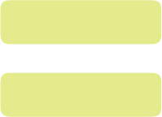
Notes:
Dan’s case is an extreme example, for sure. However, by any metric, when you consider how addiction unduly taxes the community from a criminal justice, healthcare, emergency and quality of life standpoint — taking an innovative approach to addiction care is not only the best medicine, it’s the best investment. Shifting our resources from addiction crisis management to addiction care breaks the cycle of disease and saves tax dollars.

Slide 19
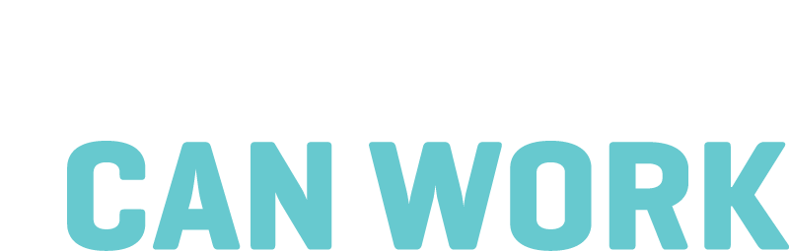

Notes:
Why should we invest in addiction care? The simple answer is, it works.
We’re a community that prides itself on innovation. This is a great place to live because we always come together, whether it’s collaborating at work, at play or in helping our neighbors in need. Sugar beets to semiconductors, fires to floods — we adapt to new challenges and embrace innovative solutions. We take care of our own. Our approach to the public health crisis of addiction should be no different.
Like in other areas of medicine and technology, there are exciting new approaches to addiction care that are getting results and saving lives.

Slide 20
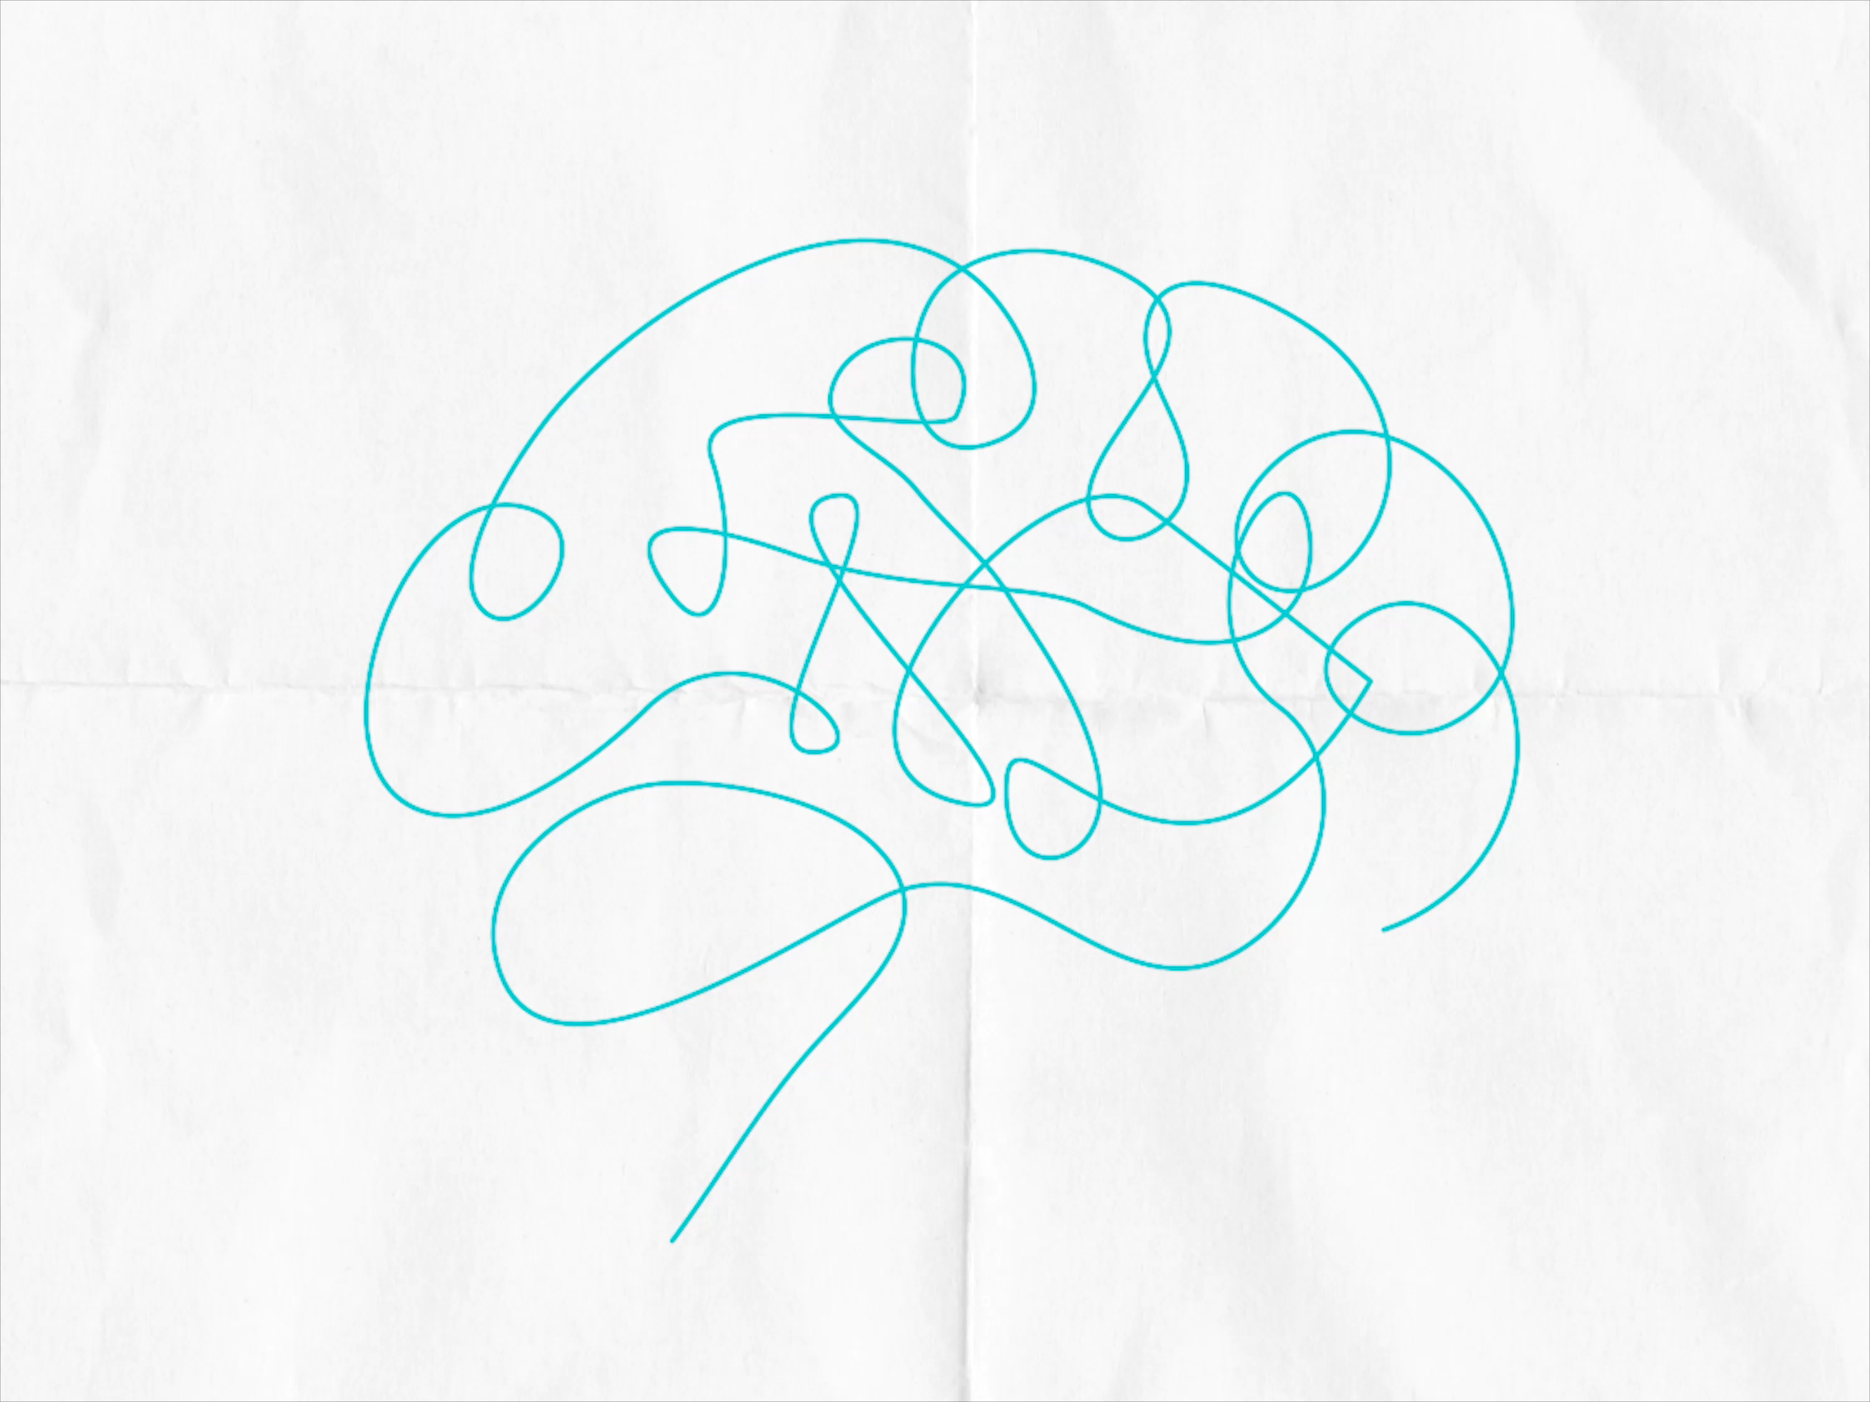
Notes:
Evidence-based medical treatment has been proven to stabilize dopamine levels and reduce cravings for those with addiction. There is hope. Recovering from addiction is always possible. With medications, treatment, and supports that address each person's needs, the brain can heal. People living with addiction can live a fuller and purposeful life in recovery.

Slide 21
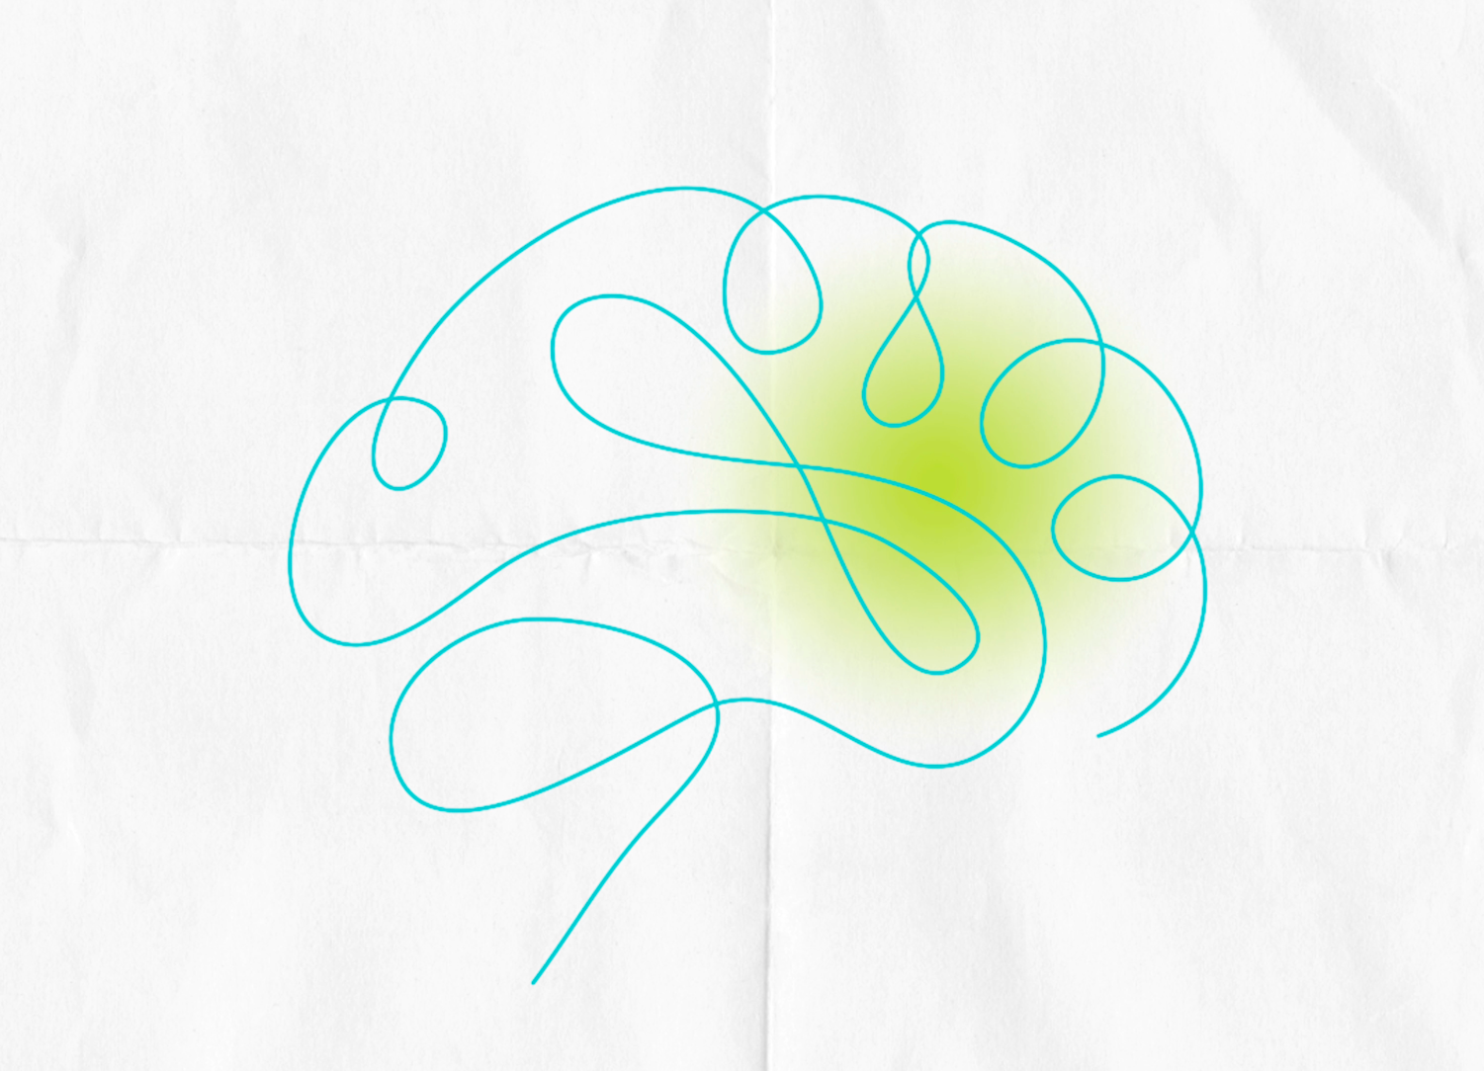
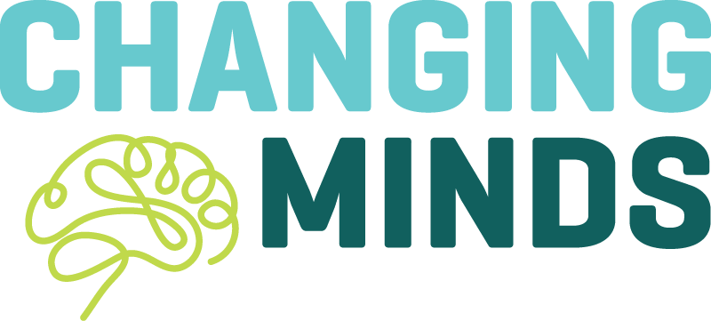
Start the conversation
Notes:
Our efforts will be measured based on how effectively we (all of us in this room) can help change minds (our own and those of our families, friends and neighbors) when it comes to addiction and addiction care.
When we change the narrative on addiction, we dispel stigma, break down barriers to care and increase awareness of the need to more effectively allocate our resources.
Changing minds can be incremental {cite your own example of how you’ve changed your mind}. Changing minds can be monumental. Changing minds can save lives.

Slide 22
ChangingMindsLarimer.org
Start the conversation
Notes:
We all know someone who has experienced or is currently experiencing addiction. The first thing we can do as a community to help combat this disease is to talk about it.
Changing minds is about starting conversations. As we head into what I hope to be a lively conversation, I’m asking all of you to consider continuing this conversation when you leave this room. Start a conversation around the dinner table, in the locker room, in the boardroom, in the classroom. You can find resources, conversation starters and deep dives into brain science on our website: ChangingMindsLarimer.org Let’s talk. {take questions}

